Slide 1
Towards more accurate resource reservations
Daniel Föhr

Slide 2
Agenda
Node Resource Reservations & cgroups
Problem Statement
The “easy solution” (not)
A better approach to resource reservations
The way forward

Slide 3
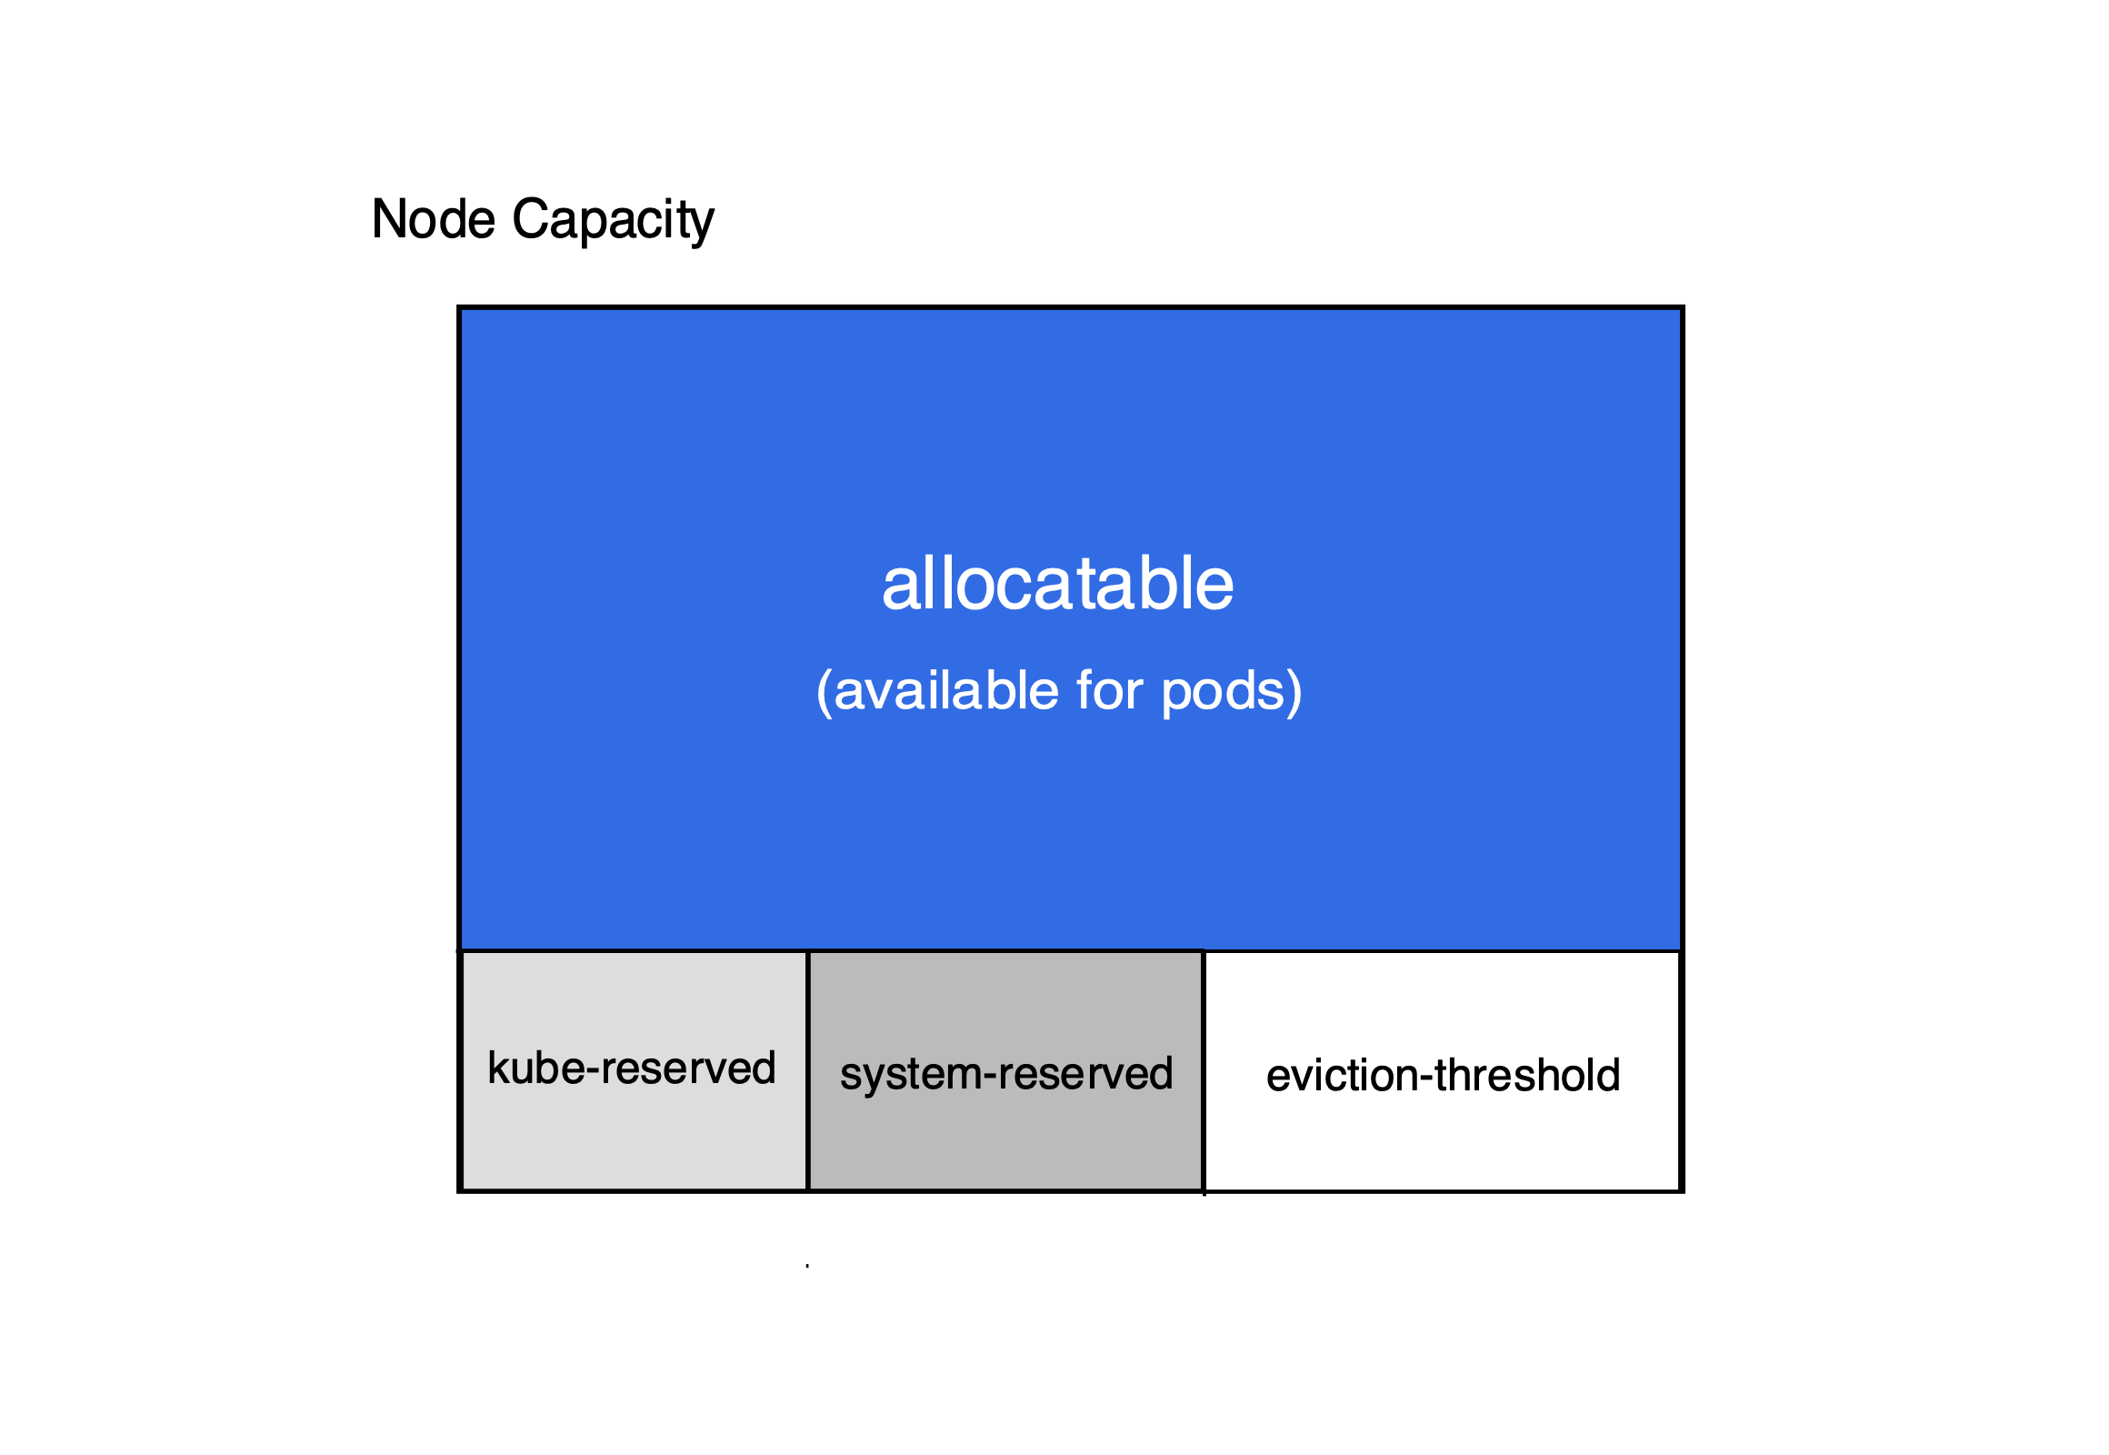
1. Node Resource Reservations & cgroups
Resources: Memory, CPU, Ephemeral Storage, PID, Inodes
$ kubectl describe node
capacity:
cpu: "2"
ephemeral-storage: 19580892Ki
hugepages-1Gi: "0"
hugepages-2Mi: "0"
memory: 7941248Ki
pods: "180”
allocatable:
cpu: 1900m
ephemeral-storage: "794680715"
hugepages-1Gi: "0"
hugepages-2Mi: "0"
memory: 4574256Ki
pods: "180"
https://kubernetes.io/docs/tasks/administer-cluster/reserve-compute-resources/

Slide 4
1.1 Memory Resource Reservation
Kubelet config
enforceNodeAllocatable:
- pods
kubeReserved:
memory: 1Gi # 1024 Mi
evictionHard:
memory.available: 100Mi
$ kubectl describe node
Capacity:
memory: 65052940Ki # 63528 Mi / 62 Gi
Allocatable:
memory: 63901964Ki # 62404 Mi / 60.94 Gi
Limit enforced on kubepods cgroup
$ cat /sys/fs/cgroup/memory/kubepods/memory.limit_in_bytes # cgroupsV1
65540468736 # 63528 Mi (Capacity) – 1024 Mi (1 Gi) = 62504 Mi / 61 Gi
Allocatable memory = 63528 Mi (Capacity) – 1024 Mi (1 Gi) – 100 Mi (Eviction Hard) = 62404 Mi = 60.94 Gi
Total Reserved: 1124 Mi
Effect:
K8s Scheduler does not schedule pods with requests > allocatable
Memory limit enforced on kubepods slice

Slide 5
1.2 CPU Resource Reservation
Linux concepts: Completely Fair Scheduler (CFS) & CFS CPU Shares & CFS Quota
CONFIG_FAIR_GROUP_SCHED extension to CFS for task/process groups
For cgroups: processes belonging to same cgroup hierarchy are in the same task group
CFS CPU Shares :
Baseline performance during resource contention.
cgroups can be guaranteed a minimum number of "CPU shares" when a system is busy.
Does not limit a cgroup's CPU usage if the CPUs have ”free” shares / are idling
CFS allows processes & process groups (via cgroups) to exceed their fair share of CPU time (defined via cpu.shares) if their competing tasks require less CPU time than their fair share.
Can be limited via CPU quotas, an extension to the CFS

Slide 6
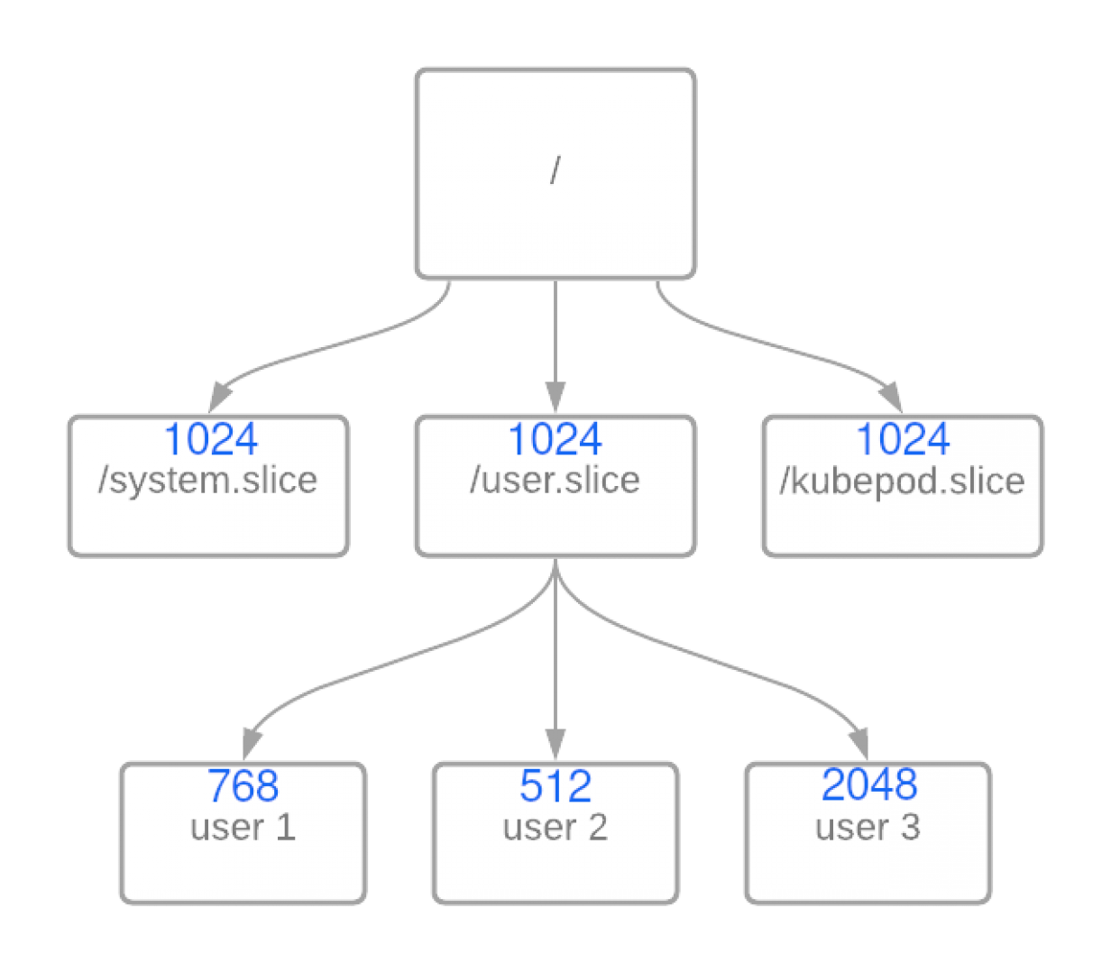
1.2 CPU Resource Reservation
In case of resource contention:
How much CPU time in % does user 1 get?
768 / (768 + 512 + 2048) = 23.1 % of parent user.slice
33.3% user.slice * 0.231 = 7.6 % total CPU time.

Slide 7
1.2 CPU Resource Reservation
CFS Quota:
Limit the amount of CPU time a task group or hierarchy (grouped by cgroup) can maximally use.
Adjustable via cgroup files in cpu cgroupfs
cpu.cfs_period_us= 100000 # 100ms cpu.cfs_quota=-1 # CFS quota disabled; Normal CFS behavior.
Max one whole CPU core for the cgroup hierarchy:
cpu.cfs_quota_us == 100000 # (100 ms)
cpu.cfs_period_us == 100000 # (100 ms)
Max two whole CPU cores:
cpu.cfs_quota_us == 200000 # (200 ms)
cpu.cfs_period_us == 100000 # (100 ms)
Sources - Google publication: CPU bandwidth control for CFS - Also see Linux kernel docs.

Slide 8
1.3 Sidenote: CPU Throtteling
If the entire CPU quota is eliminated while there are still tasks waiting to execute, the group will get throttled, even if a host has unused processor resources.
A cgroup's bandwidth statistics are exported via 3 fields in cpu.stat.
cpu.stat:
nr_periods: Number of enforcement intervals that have elapsed (of cpu.cfs_period_us).
nr_throttled: Number of times the group has been throttled/limited.
throttled_time: The total time duration (in nanoseconds) for which entities of the group have been throttled (calculation: nr_throttled *cpu.cfs_period_us )
There are two ways in which a group may become throttled:
Fully consumes its own quota within a period
A parent's quota is fully consumed within its period

Slide 9
1.4 There is more to it (out of scope)
CPU set cgroup controller
“Pin” processes to CPU cores
Kubelet: requires CPU Manager to be activated
Garuanteed QoS pods run on exclusive pool
that does not mean this core exclusively runs processes from guaranteed pods. Processes without cgroups and in user.slice and system.slice can still run on those cores (cpusets do not ensure exclusivity).
With pure Kubernetes means, I cannot exclusively reserve a CPU core for a certain process (and its cgroup).
Not enforced via cgroups: ephemeral-storage, inodes

Slide 10
2. Problem Statement
Under-reservation of Node resources (especially Memory & CPU) causes Node-instability.
CPU: Kubepods has too many CPU Shares
Starve OS processes, kubelet, container runtime for CPU time in case of CPU contention
Memory: see next slides.

Slide 11
2.1 Problem on Gardener landscapes
Challenge:
Nodes replaced before able to analyze
Manifests in various ways
Many (unresolved) issues
OS OOM before eviction: https://github.tools.sap/kubernetes-live/issues-live/issues/525
Node OOM: https://github.tools.sap/kubernetes-live/issues-live/issues/335
Node flapping (PLEG) not healthy: https://github.tools.sap/kubernetes-live/issues-live/issues/529
Likely CPU starved (see here)?

Slide 12
2.2 Detect CPU under-reservation
How much CPU % does the system.slice gets based on the configured CPU shares?
Calculation:
(Active cgroup CPU shares) / (sum of all possible CPU shares of the cgroup SIBLINGS) = 1024 / (16302 + 1024) = 0.059 = 5.9 % total CPU time of 16 cores
= 94 % of ONE core
Current CPU consumption: system-cgtop
Average CPU consumption: use /sys/fs/cgroup/cpu/$cgroup/cpuacct.usage

Slide 13
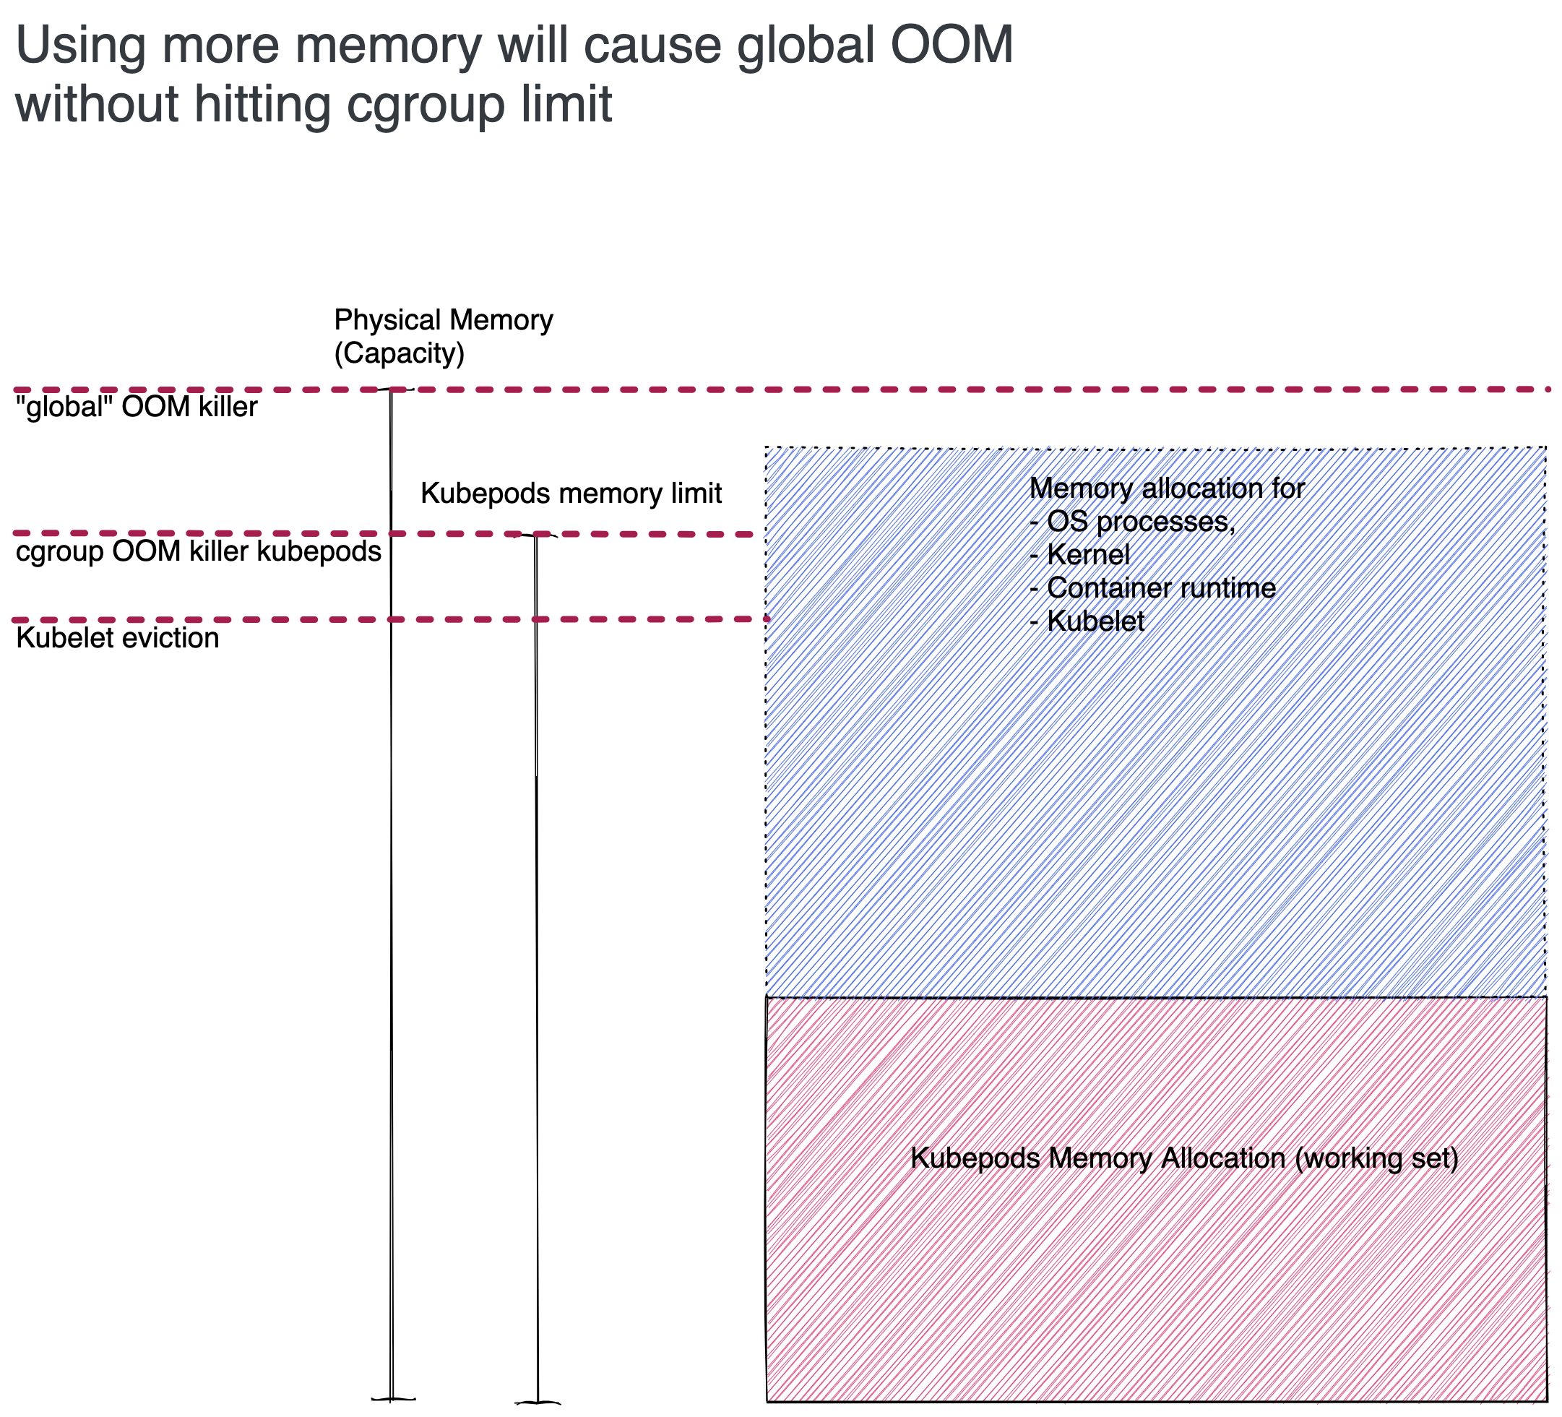
2.2 Memory under-reservation
Kubepod’s memory limit is too high
“Global” OOM before kubepods cgroup OOM or Kubelet eviction
Kills OS processes, kubelet, container runtime
OS deadlock -> kubelet no heartbeat -> Node Not Ready
Kubelet eviction only triggers close to cgroup limit

Slide 14
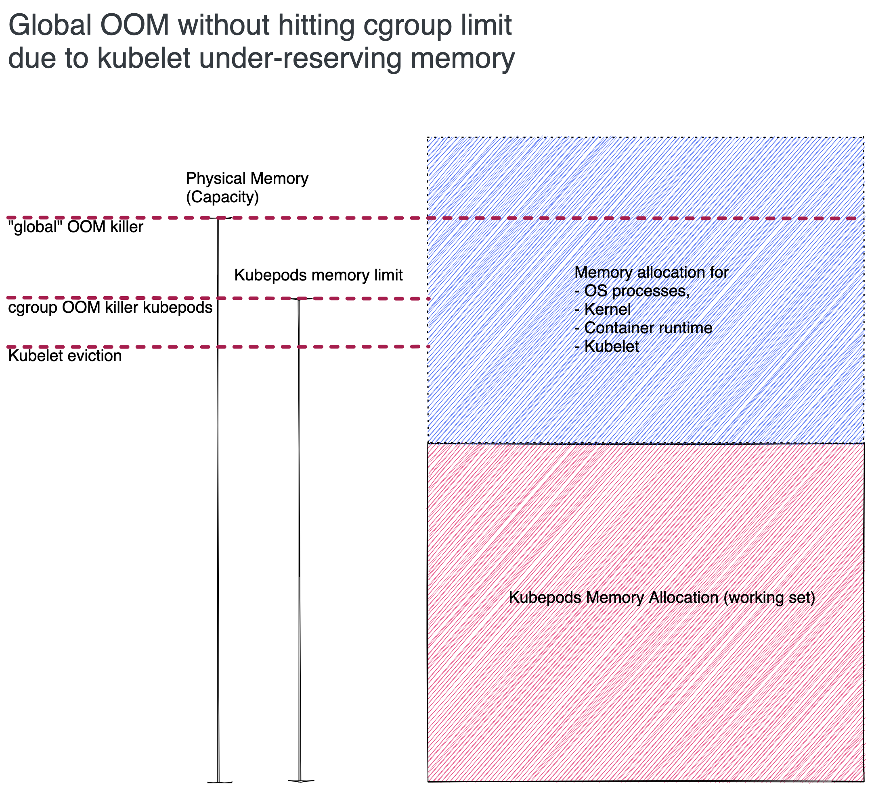
Global OOM is hit killing any OS process based on oom_score (not kubelet eviction order)

Slide 15
Show: Memory under-reservation
https://go-shoot-garden-aws-eu1.ingress.eu1.gcp.soil.canary.k8s.ondemand.com/d/node-details/node-details?orgId=1&refresh=1m
Kubelet & docker memory consumption > reserved memory

Slide 16
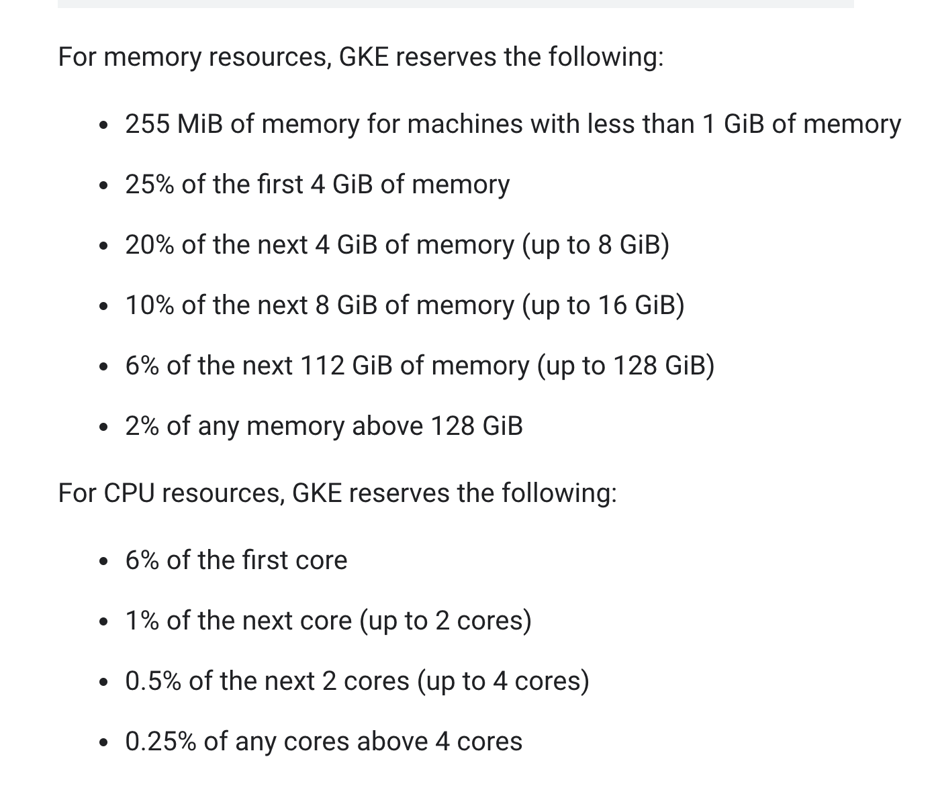
3. The “easy solution” (not)
Calculate resource reservations based on the machine size (GKE, Azure, OpenShift, .. (not Gardener))
Sources
IBM Cloud: https://cloud.ibm.com/docs/containers?topic=containers-service-settings
GKE: https://cloud.google.com/kubernetes-engine/docs/concepts/cluster-architecture
Azure: https://docs.microsoft.com/en-us/azure/aks/concepts-clusters-workloads#resource-reservations
Openshift: https://github.com/openshift/enhancements/pull/642/files

Slide 17
3. The “easy solution” (not)
My Opinion: Reserved resources cannot be accurately calculated in advance without exactly knowing the (pod) workload.
Result: Heavy under-reservation (see issues) e.g if our Seed clusters would use GKE’s calculations.
Why?
Required resources (CPU, Memory,..) for kubelet and the container runtime are dependent on
The amount of pods running (max pods -> over reserving)
The kind of workload (Compare Seed vs. Shoot)

Slide 18
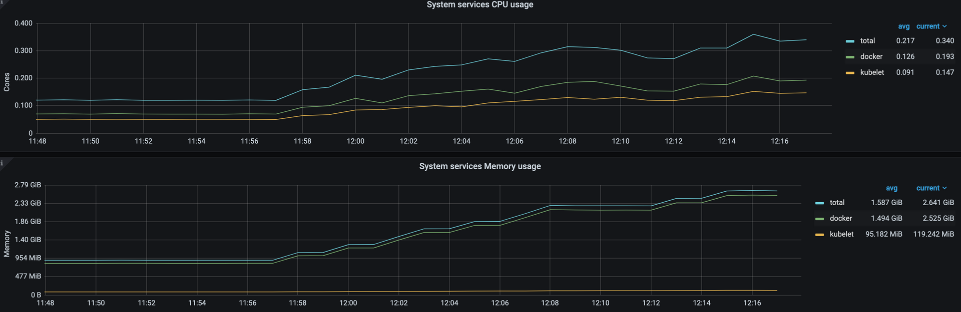
The “easy solution” (not)
Amount of pods deployed 10 – 100

Slide 19
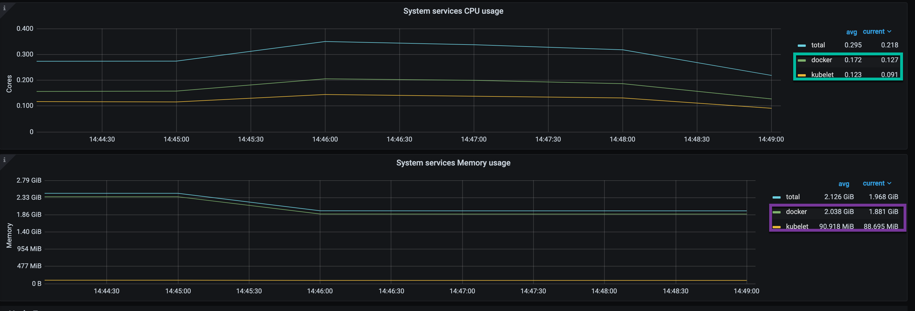
The “easy solution” (not)
Seed vs. Test Cluster kubelet & container runtime consumption with same number of pods (73 in total)
Test Shoot (Gardenlinux, 73 pods with sleep process)

Slide 20
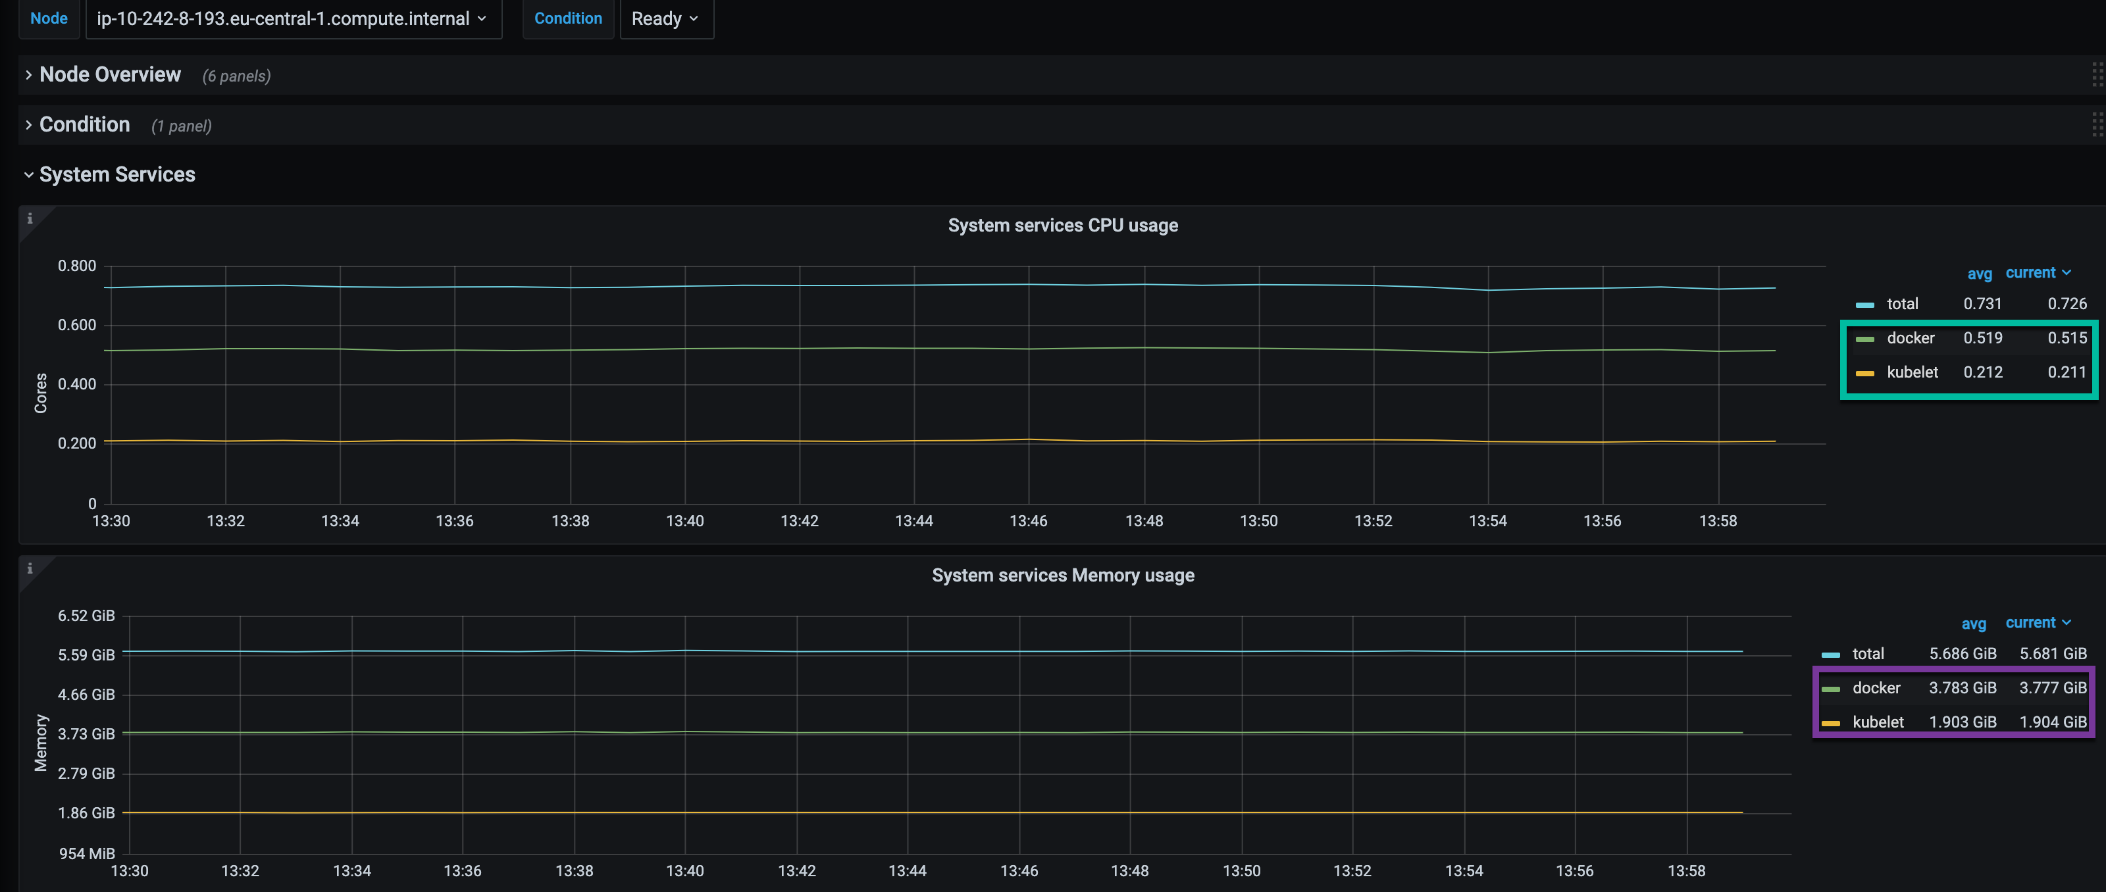
The “easy solution” (not)
Seed-node on aws-eu-1 (Gardenlinux, 73 pods)

Slide 21
4. A better approach to resource reservations
Idea: reconcile the limit of the kubepods cgroup based on the resource consumption of non-pod processes.
leads to better scheduling decisions
Correct kubepods cgroup limits prevent “global” OOM + enable kubelet eviction
PoC here: https://github.com/danielfoehrKn/better-resource-reservations

Slide 22
4.1 A better approach to resource reservations
/proc/meminfo "MemTotal”: Total physical memory available on the system.
/proc/meminfo "MemAvailable" : Total OS memory available without going into swapping
working_set_bytes : "working set memory" of a process / cgroup
the amount of memory in-use that cannot be freed under memory pressure
Derived from cgroup stats: Memory.usage_in_bytes – memory.stat “Inactive_file”
See the Kubernetes docs
Idea: calculation of reserved memory
Reserved memory = MemTotal - MemAvailable - working_set_bytes (kubepods cgroup)

Slide 23
Can we use the Metrics API?
Node memory consumption according to Metrics API
$ k top nodes
NAME CPU(cores) CPU% MEMORY(bytes) MEMORY%
ip-10-240-22-124.eu-west-1.compute.internal 279m 14% 2442Mi 37%
ip-10-240-9-244.eu-west-1.compute.internal 351m 18% 3199Mi 48%
Metrics API uses container_memory_working_set_bytes exposed by kubelet via cadvisor
PromQL: container_memory_working_set_bytes{id="/"}
This is the working set memory of the root memory cgroup.

Slide 24
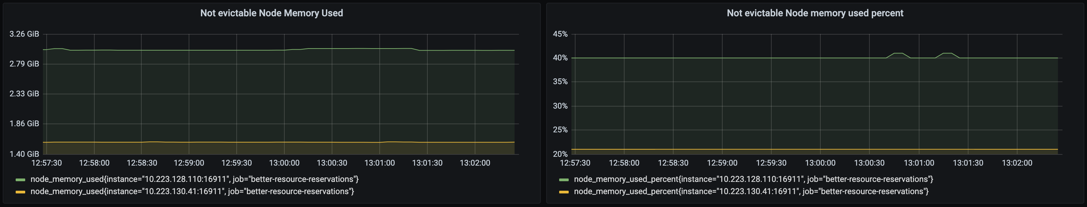
Can we use the Metrics API?
Compare with memory usage derived from /proc/meminfo
40 % used via 48% used based on Metrics API
“Global” OOM when /proc/meminfo MemAvailable ≈ 0
→ Use /proc/meminfo for reserved-memory calculation

Slide 25
Demo: “Global” OOM
Grafana
http://localhost:3000/d/IMdqrrRnx/better-resource-reservations?orgId=1
Use loadtest node ip-10-240-20-43.eu-central-1.compute.internal with under reservation to demonstrate OOM

Slide 26
Demo: Prevent “Global” OOM via PoC

Slide 27
The way forward
Resource reservation based on a pre-defined heuristic is problematic (“superficial fix”)
Currently kubelet
sets kubepods cgroup settings after startup based on its configuration
has no mechanism to reconcile resource reservations at runtime
Reconciling resource reservations could probably be put into kubelet
Directly adjusting the kubepods cgroup via an external script is possibly not a good idea (race with kubelet?)
Restarting kubelet is dangerous (API requests, …)
https://github.com/kubernetes/kubernetes/issues/103046

